Slide 1
Module 5 Architectures, Features, and Details of Data Integration Tools
Lesson 4: Pentaho Data Integration
Notes:
Welcome to Lesson 4 of Module 5 on Architectures, Features, and Details of Data Integration Tools.
Opening question
- Which data integration tool do you prefer, Talend or Pentaho and why?

Slide 2
Lesson Objectives
List major features of Pentaho Data Integration
Gain familiarity with Pentaho features for jobs and transformations
Gain experience with Pentaho on the practice exercise and assignment
Notes:
Lesson 4 covers the features of Pentaho Data Integration, a prominent open source product
Objectives:
Compare and contrast the approaches and features of Talend and Pentaho
List major features of Talend Open Studio for data integration
List major features of Pentaho data integration
Compare and contrast the approaches and features of Talend and Pentaho
Practice using Pentaho on data integration workflows using the Pentaho demonstration and assignment

Slide 3




Pentaho Products
Platform for data integration, business analytics, and big data
Open core business model
Pentaho Data Integration
Pentaho Business Analytics
Pentaho Big Data Analytics
Notes:
Pentaho Data Integration
Visual designer for transformations and jobs
Big data support
Administration and management’
Data profiling and quality
Subscription and open source versions
Pentaho Business Analytics
Interactive visual analysis
Geo-mapping, heat grids, scatter/bubble charts
Visualization plugins
Pentaho Big Data Analytics
Big data sources
Extreme scale data caching
Visualization and data analytics

Slide 4
Pentaho Data Integration
Editions
Subscription service from Pentaho website
Community edition: Kettle
Basic concepts
Transformation with data flow among steps and hops
Job with data flow among transformations and external entities
Tools:
Spoon: graphical design of transformations and jobs
Pan and Kitchen: execution of transformations and jobs
Notes:
Community edition available from SourceForge
Concepts
Transformation: data flow
Step: process
Hop: connects steps
Job: coordinate transformations such as order and dependencies (such as file availability)
Tools:
Spoon for visual design of transformations and jobs
Pan executes transformations
Kitchen: executes jobs

Slide 5
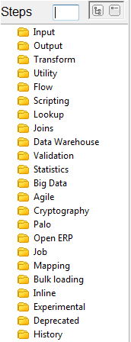












Transformations
Step: process in a data flow
Input/Output
Transform: sort, split, concatenate, …
Flow: filter rows
Lookup: existence of rows, tables, files, …
Join: merge join, multiway merge, …
Validation: credit card, mail, data
Hop: directed connection between steps
Database connections
Distributed processing: partition, cluster, …
Notes:
Steps:
Input/Ouptut: Text file input, Excel file output
Transform: Concatenate fields, Select values
Flow: filter rows, switch case
Lookup: database lookup, table exists
Joins: merge join, multiway merge
Validation: Data validator, credit card validator
Other categories: see step list

Slide 6
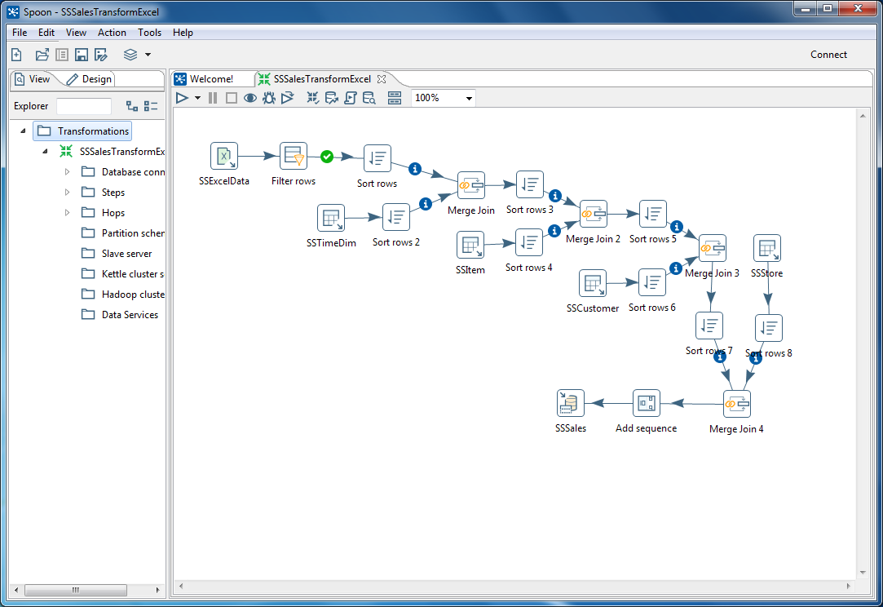
Spoon IDE
Execution controls
View
pane
Canvas
Notes:
Spoon:
Visual design of transformations and jobs
Simpler interface than Talend
View tab
Lists components for current model
Expand folders to see details
Design tab shows step categories and steps

Slide 7

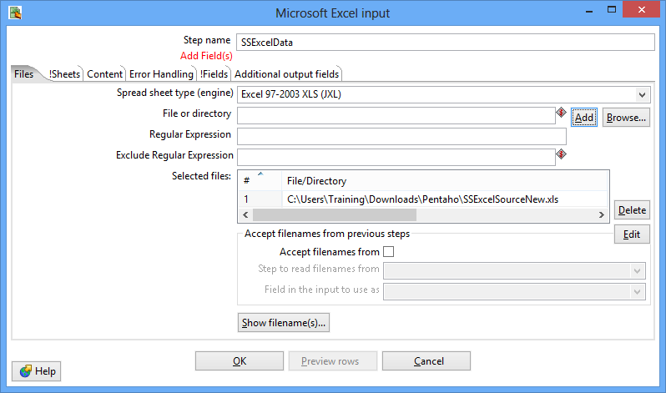
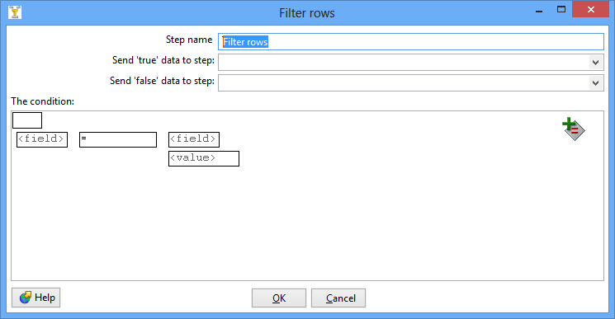
Example Transformations
Notes:
Input step: Microsoft Excel
Flow step: Filter rows
Hop: from excel input to filter rows
Dialogs for step details
Excel input: specify file location, worksheet, fields in worksheet
Filter rows: conditions to keep rows such as non null, regular expression, comparison operator, …

Slide 8
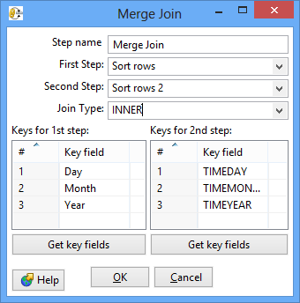
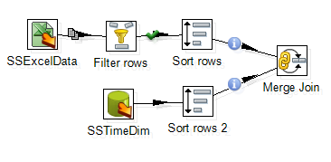
Merge Join Step
Notes:
Merge excel input (no timeno field) with SSTimeDim table containing a TimeNo column.
Identify matching fields
Sort rows step because merge join requires sorted data sources

Slide 9
Summary
Prominent open source tools (Talend and Pentaho)
Community and subscription editions
Supports specification of transformations and steps and transformation execution
Use Pentaho for exercise and assignment
Notes:
Prominent open source tools: not sure about the market share but continue to evolve with new versions so some market acceptance
Editions:
Open: standard open source license for usage and distribution
Subscription editions: more features and support
Basic features supported
Integrated development environment
Graphical specification
Job management
Transformation libraries
Use Pentaho software demonstration and complete assignment

Slide 10
Talend versus Pentaho
Pentaho advantages
Incremental execution
Easier to export
Easier reuse of database connections
Talend advantages
More compact specification especially for multiple joins and not null checks
HTML documentation generation
Notes:
Incremental execution
Execute partial transformations
No need to rebuild complex transformations to execute part of a transformation
Facilitates debugging: find step with a processing error

